Slide 1


Part 6: The Mark of the Beast

Slide 2
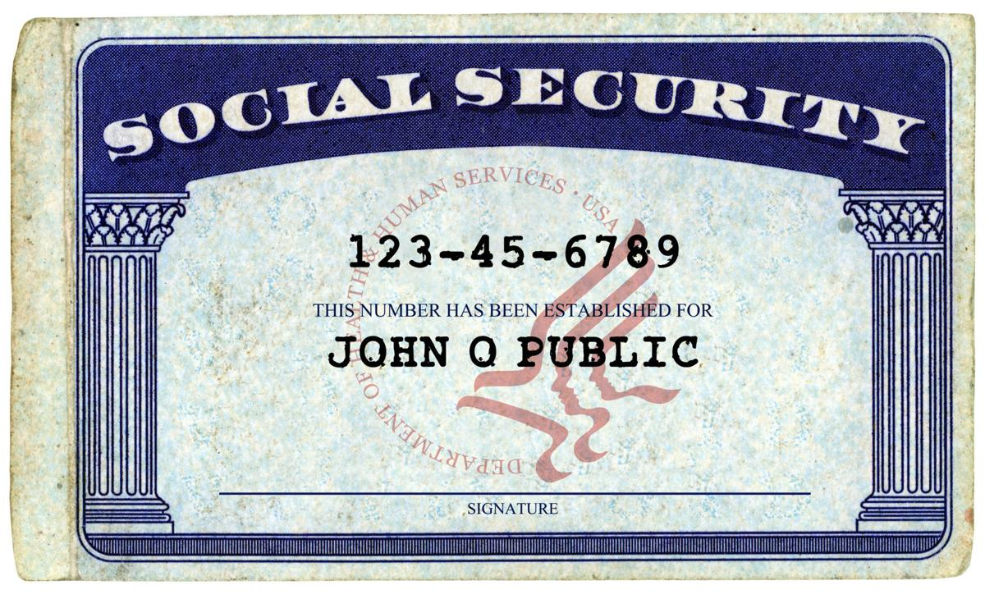

Slide 3
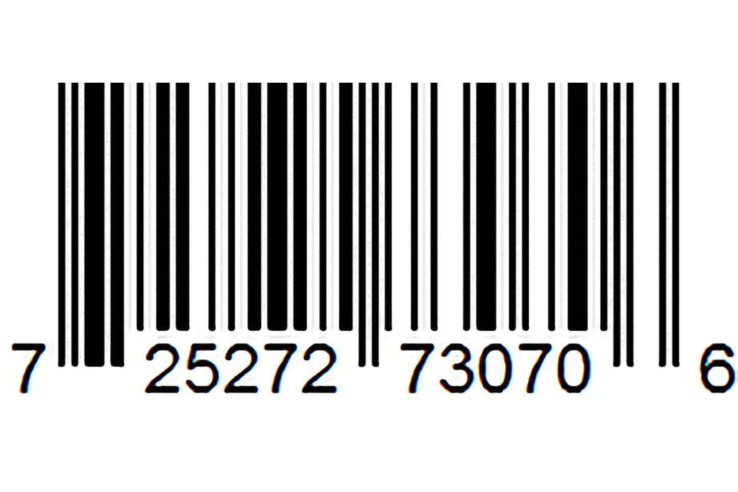

Slide 4
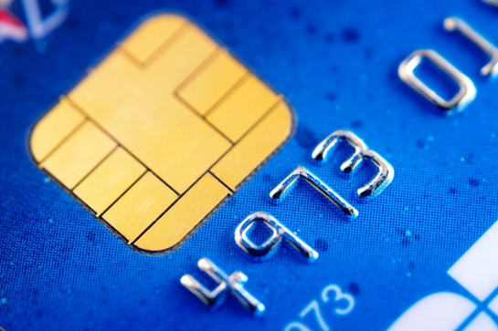

Slide 5


Slide 6
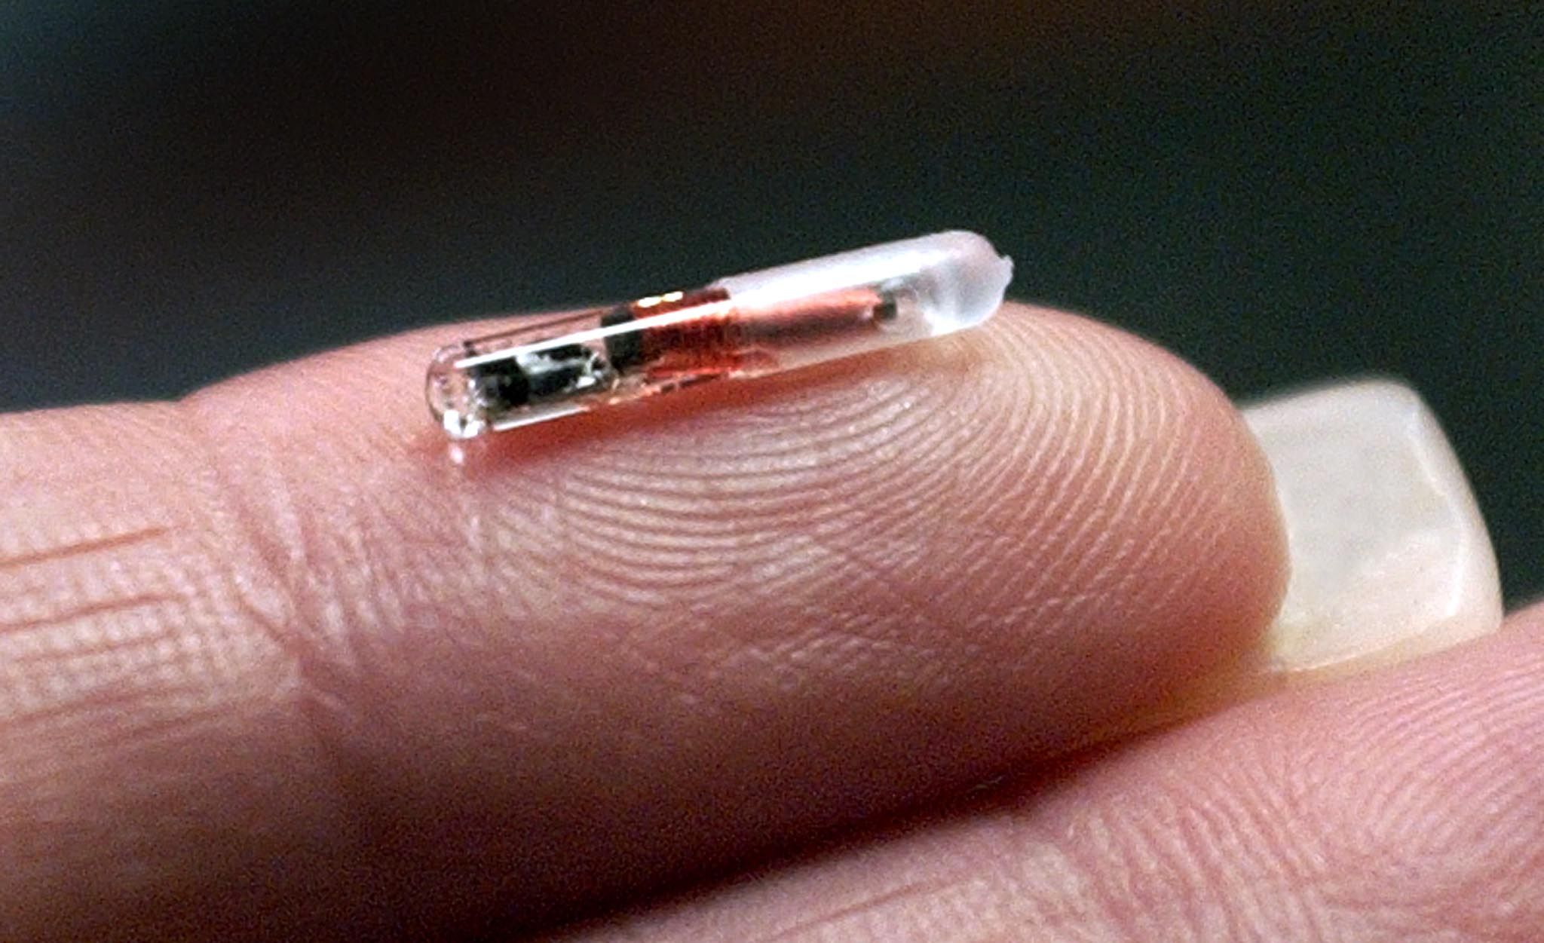

Slide 7


Slide 8


Slide 9
What is Revelation?
Revelation 1:1-11;19

Slide 10
Three ways to interpret Revelation:

Slide 11
Three ways to interpret Revelation:
1. Futurism: the visions tell what will
happen at the end of the world.

Slide 12
Three ways to interpret Revelation:
1. Futurism: the visions tell what will
happen at the end of the world.
2. Preterism: the visions refer to things happening at the time it was written.

Slide 13
Three ways to interpret Revelation:
1. Futurism: the visions tell what will
happen at the end of the world.
2. Preterism: the visions refer to things happening at the time it was written.
3. Idealism: the visions communicate
existing Biblical truth in symbol.

Slide 14
The Mark of the Beast:
Revelation 13:16-18

Slide 15
The Mark of the Beast:
Revelation 13:16-18
“Mark” in Greek is charagma and means
a stamp, brand, badge, or engraving
for the purpose of identification.

Slide 16
The Mark of the Beast:
Revelation 13:16-18
“Mark” in Greek is charagma and means
a stamp, brand, badge, or engraving
for the purpose of identification.
This means the mark of the beast cannot be something that is taken secretly or accidentally.

Slide 17
The Mark of the Beast:
Revelation 13:16-18
Jews assigned meaning to numbers
and used gematria to assign numerical
values to words, phrases and names.

Slide 18
The meaning of the mark:
1. Futurism: a visible mark of the beast’s name will be required to buy or sell. Rev. 14:1

Slide 19
The meaning of the mark:
1. Futurism: a visible mark of the beast’s name will be required to buy or sell. Rev. 14:1
2. Preterism: in Hebrew gematria, the Roman Emperor Nero’s number is 666.

Slide 20
The meaning of the mark:
1. Futurism: a visible mark of the beast’s name will be required to buy or sell. Rev. 14:1
2. Preterism: in Hebrew gematria, the Roman Emperor Nero’s number is 666.
3. Idealism: the mark is a symbol of allegiance. Deuteronomy 6:4-8; Revelation 14:12

Slide 21
We must be humble and careful
when interpreting Revelation.
Revelation 22:18-19

Slide 22
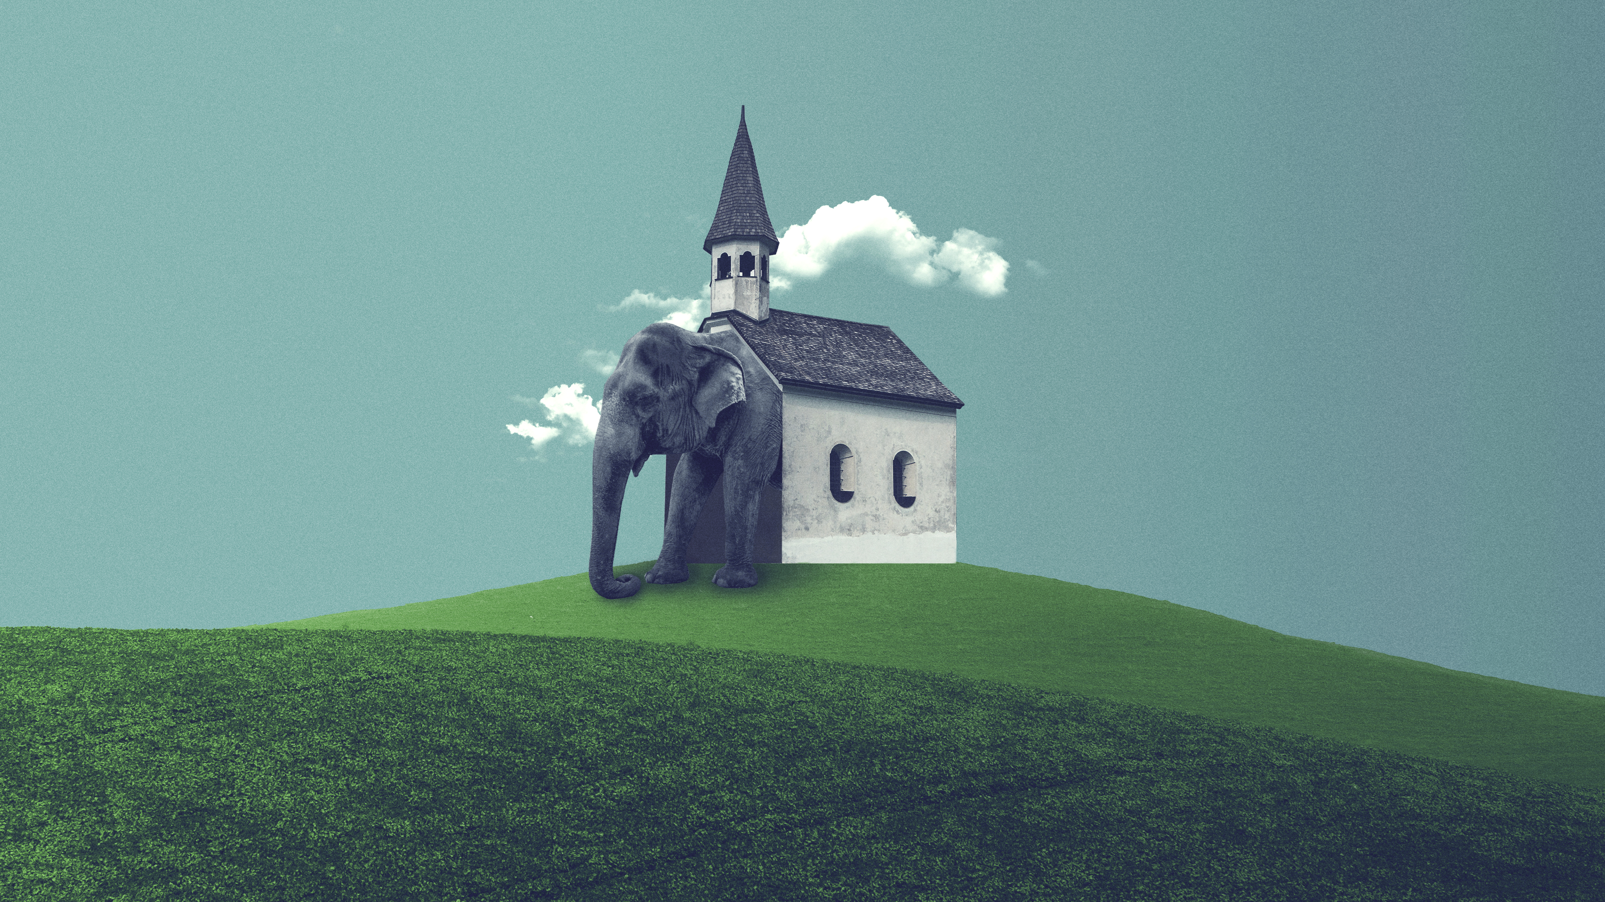
Have you been marked by Jesus?

