Slide 1

Part 4: Grow Up

Slide 2
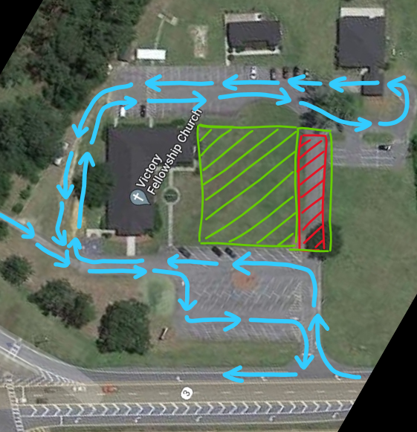

Slide 3


Slide 4


Slide 5
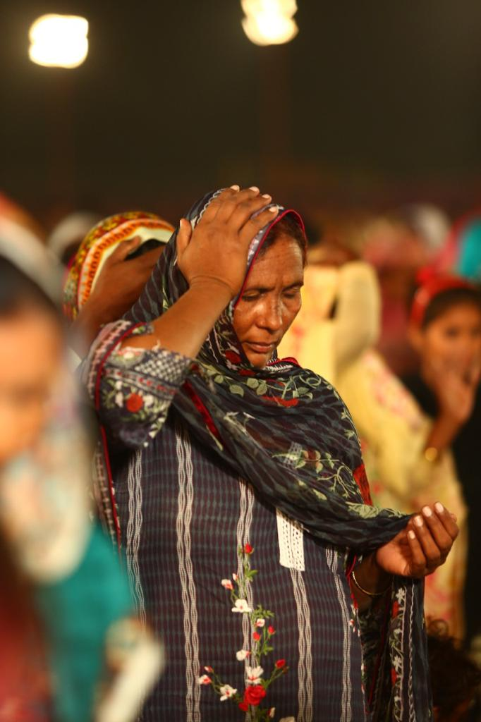
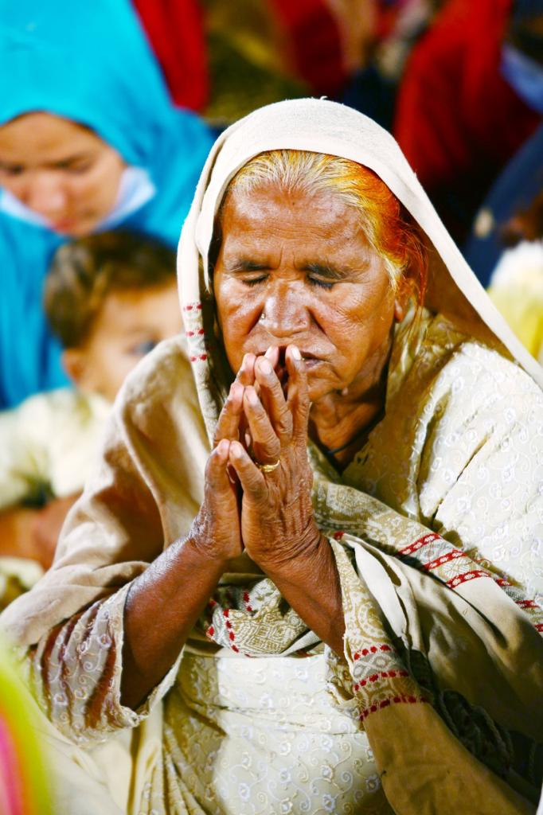


Slide 6
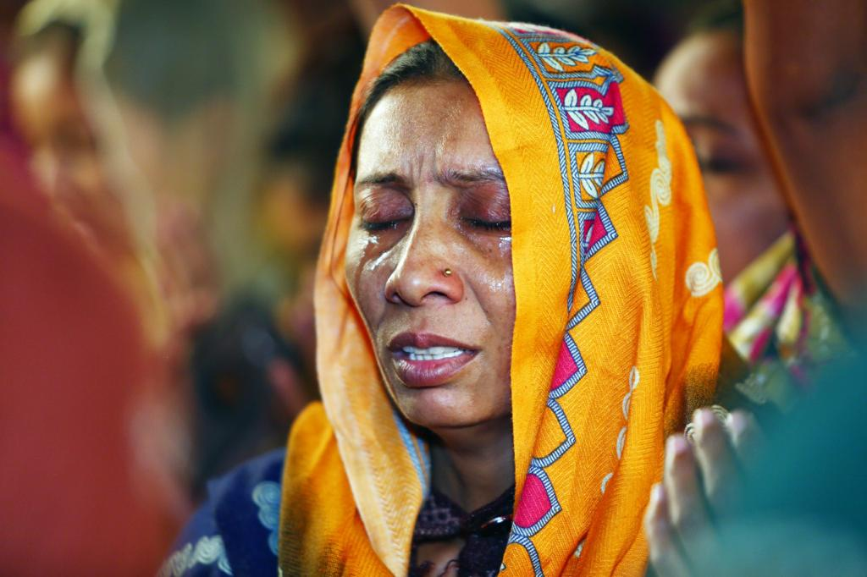

Slide 7

49,193 salvations!

Slide 8
Part 4: Grow Up

Slide 9

The fruit of the spirit are the various positive character traits displayed in the life of a believer, that are the result of an ongoing, healthy relationship with God.

Slide 10

“But the fruit of the Spirit is love, joy, peace, patience, kindness, goodness, faithfulness, gentleness, self-control; against such things there is no law.” Galatians 5:22-23

Slide 11
“But the fruit of the Spirit is love, joy, peace, patience, kindness, goodness, faithfulness, gentleness, self-control; against such things there is no law.” Galatians 5:22-23

Slide 12
Christians are expected to grow up.
1 Corinthians 13:11

Slide 13
Fruit that helps us grow up:

Slide 14
Fruit that helps us grow up:
1. Goodness
Goodness is moral virtue, uprightness,
and excellence of character.
Ephesians 5:8-10
Ephesians 2:10

Slide 15
Fruit that helps us grow up:
2. Faithfulness
Faithfulness is confident trust
that results in loyalty and reliability.
Luke 16:10
2 Timothy 2:2

Slide 16
Fruit that helps us grow up:
3. Self-control
Self-control is the ability to manage
your appetites and emotions.
Proverbs 25:28
1 Corinthians 9:27

Slide 17

Are you bearing the fruit of the Spirit that helps you grow up?

