Slide 1


Part 1: God, Gender, & the Trans Community

Slide 2
Biological sex: male or female, based on anatomy
Gender: the social understanding of biological sex
Gender identity: how someone relates to
and expresses their gender
Gender dysphoria: when someone’s gender identity doesn’t match their biological sex.
Transgender: when someone takes steps
to physically transition to a gender
that doesn’t match their biological sex.

Slide 3
What does the Bible say
about sex and gender?
Genesis 1:27
Deuteronomy 22:5
1 Corinthians 11:14-15
Scripture speaks of sex and gender as binary
and fixed, with male and female only.

Slide 4
What does current culture say
about sex and gender?
Until recently, gender was synonymous with sex.
John Money is the father of gender identity

Slide 5
Who identifies as trans/non-binary?
1.6% of all U.S. adults
0.3% of adults 50+
1.6% of adults 30-49
5.1% of adults 18-29
10% of teens 12-17 identified as LGBTQ+

Slide 6
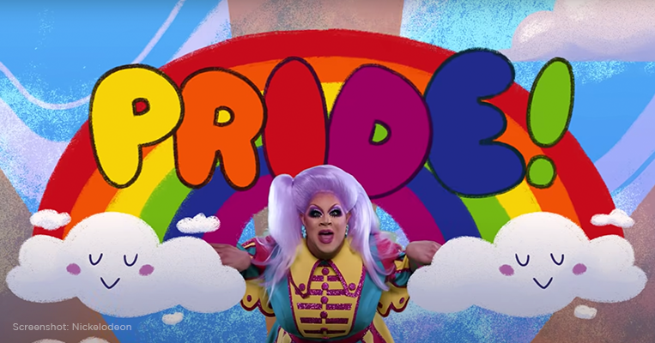

Slide 7
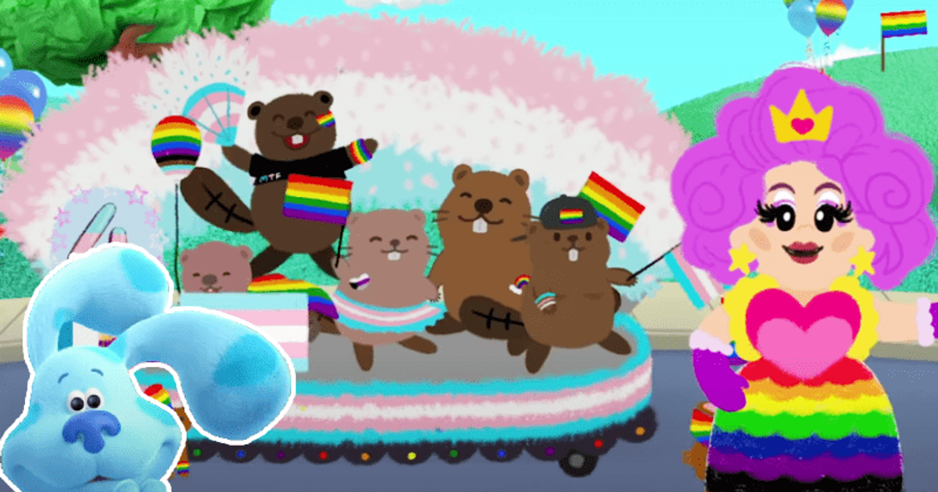

Slide 8
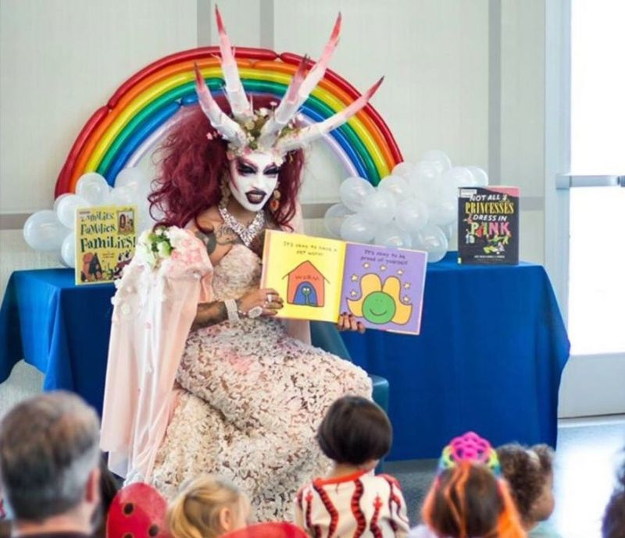

Slide 9


Slide 10
How should the church respond?
1. Distinguish between people with gender dysphoria and gender-identity activists.
Galatians 6:1-2

Slide 11
How should the church respond?
2. Encourage people to
find their identity in Christ.
John 1:12-13

Slide 12
How should the church respond?
3. Show others how to utilize
God’s tool of mind renewal.
Romans 12:2

Slide 13
How should the church respond?
4. Don’t forget that
Christians fight differently!
2 Corinthians 10:4-5

Slide 14
How should you respond to a loved one struggling with their gender identity?
1. Protect your relationship with them.
2. Pray for them and with them.
3. Embrace an eternal perspective.

Slide 15
If you’re struggling with gender identity,
we love you and we want to see you happy, healthy and confident in who you are in Christ.
VFC is not an “affirming” church,
but we are an “accepting” church.

Slide 16
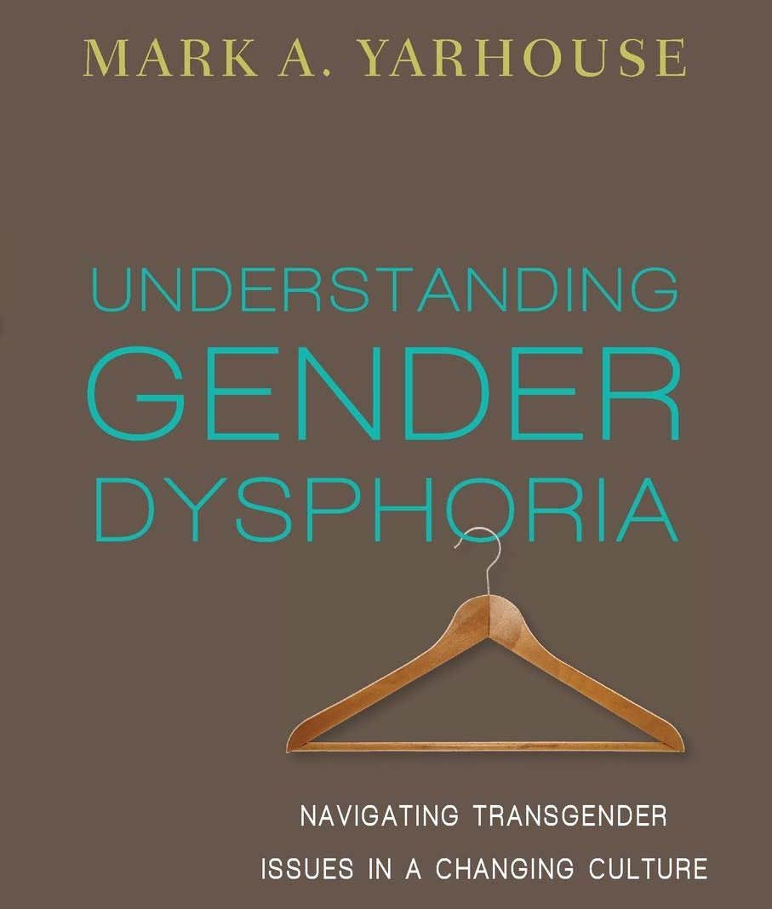
Suggested Resource:

Slide 17

Will you let God determine what you think about gender?

